Slide 1

DETECT - U
Let's Detect-U

Slide 2

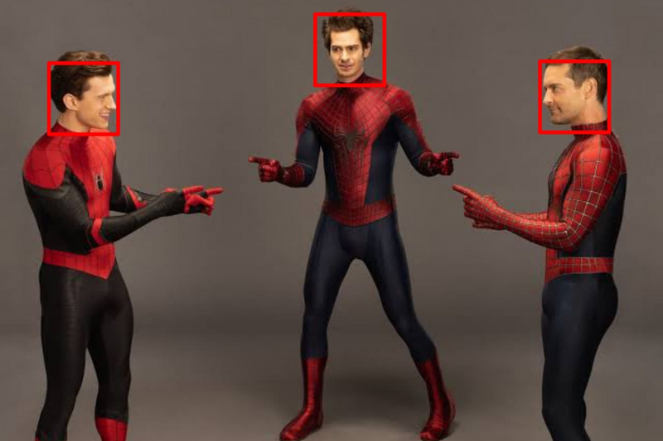
DETECT-U
What is Face Detection?
Why we use Face Detection?
Our Work
Conclusion
References

Slide 3
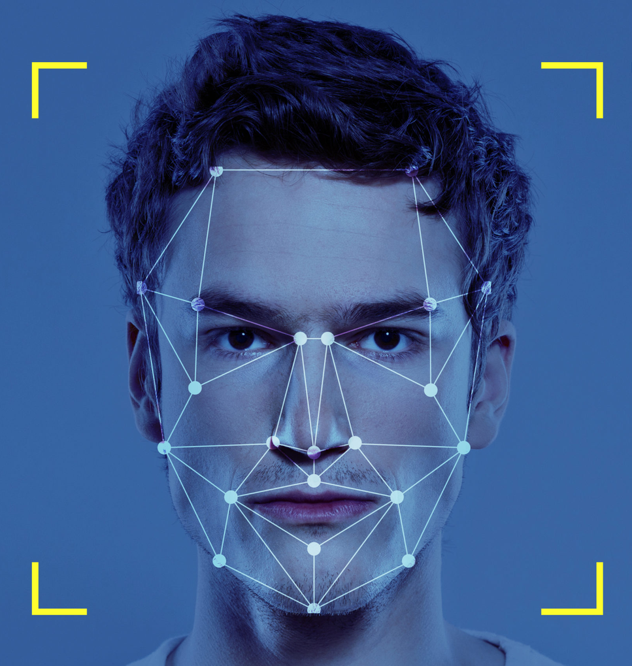
What is face detection?
Face detection is the process of automatically identifying or verifying the presence of a human face in digital images or video frames.

Slide 4
Face Detection
Face Recognition
Face detection is used to locate faces in an image or video.
Face recognition is used to identify who the person is.
Face detection produces bounding boxes around detected faces
Face recognition produces a label or name for the identified person.
Face detection systems may be able to use a smaller dataset or may not require labeled data.
Face recognition systems typically require a large dataset of labeled images for training.

Slide 5
Why use Face Detection?
1
2
3
4
Security
AR
Image Editing
Social Media
Face detection can be used as a security measure to identify people in a crowd or to verify the identity of an individual.
Face detection can be used in augmented reality applications to trigger certain events or actions when a face is detected in the camera's field of view.
Face detection can be used in image editing software to automatically detect and crop faces in photographs.
Face detection can be used in social media applications to automatically tag people in photos.

Slide 6

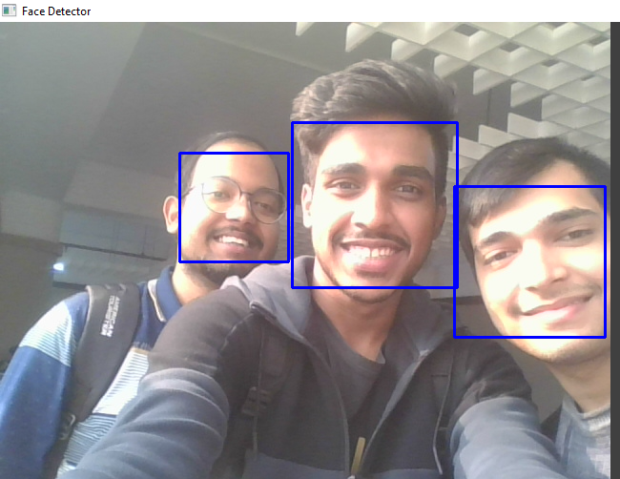
Our Work
Overview of Open CV
Haar Cascades in Open CV
Accuracy of IMG
Face Detection using Open CV & Django
Implementing Front End

Slide 7
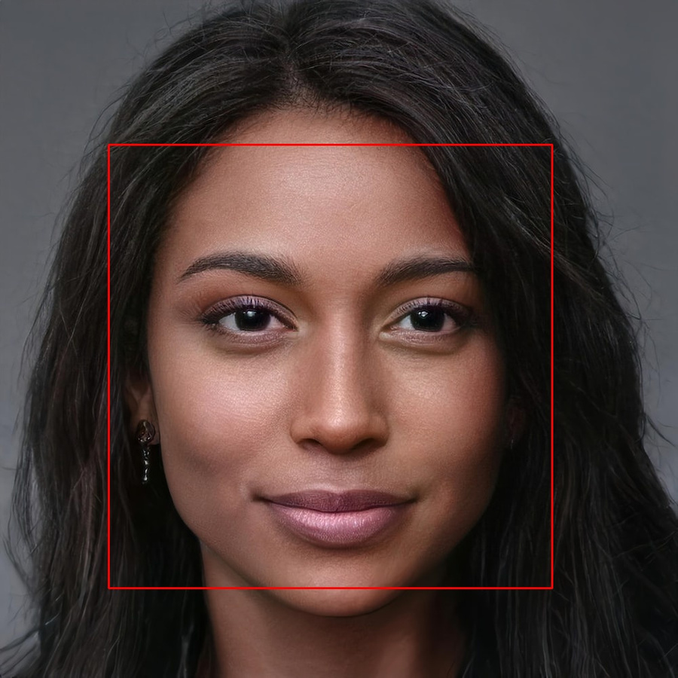
Overview of Open CV
OpenCV (Open Source Computer Vision) is a free and open-source library of computer vision and machine learning algorithms designed to help developers build advanced computer vision applications.

Slide 8

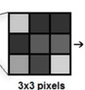



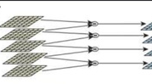
Various Algorithms of OpenCV
Haar Cascades
Local Binary Patterns
Scale Invariant Feature Transform (SIFT)
This is a machine learning object detection method used to identify objects in images or video.
This is a texture descriptor used to identify patterns in images. LBP can be used for face detection, as well as other object detection tasks.
This is a feature detection and description algorithm that is similar to SIFT. SURF is generally faster than SIFT, but may be less robust.

Slide 9

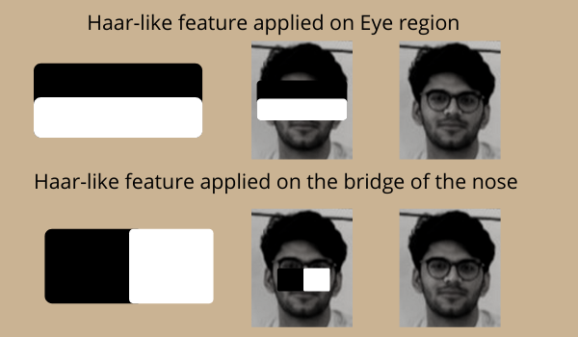
Haar Cascades in OpenCV

Slide 10
cv2.CascadeClassifier
Load the classifier using the cv2.CascadeClassifier class.
How Haar Cascades can be used for face detection in OpenCV?
image = cv2.imread('input.jpg')
Load the input image or video frame.
gray = cv2.cvtColor(image, cv2.COLOR_BGR2GRAY)
Convert the input image or frame to grayscale, as Haar cascades operate on grayscale images.
faces = classifier.detectMultiScale(gray)
Use the detectMultiScale() method of the cv2.CascadeClassifier class to detect faces in the input image or frame.
cv2.rectangle
Iterate through the list of bounding boxes and draw a rectangle around each face using the cv2.rectangle function.

Slide 11


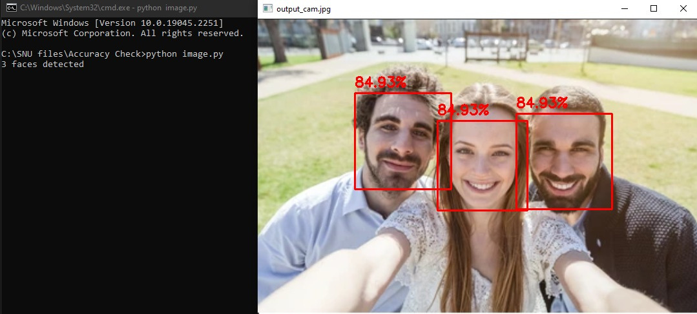
Accuracy of Image
The accuracy of face detection refers to the ability of a face detection system to correctly identify the presence and location of faces in an image or video.

Slide 12
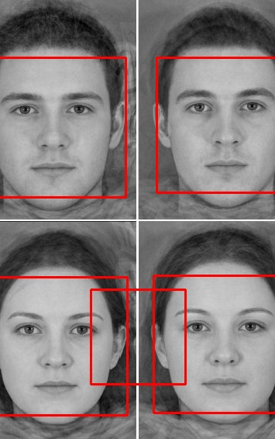
Face Detection using OpenCV and Django
We use various machine learning algorithms and specialized software libraries, such as OpenCV and Django, which enable the detection of facial features and facial expressions in real-time.

Slide 13
1
Install OpenCV and Django on your server.
2
Create a Django project and app.
Explanation of how to use OpenCV for face detection in a Django web application
3
Create a view function in your Django app to handle face detection requests for input/output.
4
Load the Haar cascade classifier using the cv2.CascadeClassifier class and use it to detect faces in the input image.
5
Iterate through the list of detected faces and draw a rectangle around each face using the cv2.rectangle function.
6
Save the output image to a temporary file and return it as the response to the request.
6

Slide 14

Implementing the frontend

Slide 15
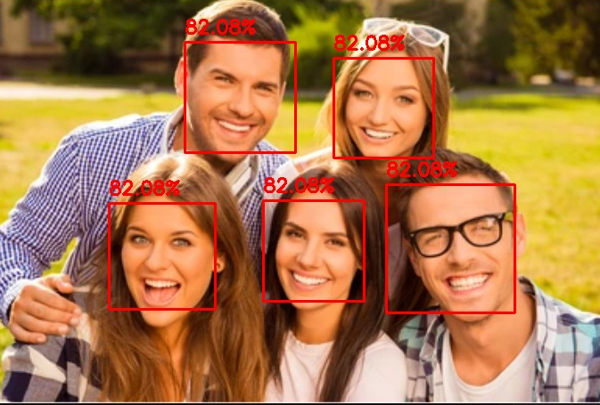
Conclusion:
In conclusion, OpenCV is a powerful library for performing face detection in a variety of applications. By using Haar cascades or other algorithms, you can accurately detect faces in digital images and use this information in a range of applications. However, it is important to consider the accuracy of the results and the limitations of the technology.

Slide 16

REFERENCES
GeeksforGeeks
YouTube
Tailwind CSS and Tailblocks
Analytics Vidya
Pinterest

